Slide 1



PROJECT ON
Customer Churn Analysis
Presented by: M. SHARATH KUMAR
BATCH.No: 450
Subject: POWER BI
Branch: Dilsukhnagar

Slide 2
About me
I am MORANGAPALLI SHARATH KUMAR
I completed my graduation in the stream of B.sc(MSDS) and Degree from Govt degree college of Khairatabad.
LinkedIn: https://www.linkedin.com/feed/?trk=guest_homepage-basic_google-one-tap-submit

Slide 3
Agenda(The Game Plan)
Problem: Why Are Customers Leaving?
Objective (The Mission)
Dataset Overview :Our Big Map of Data (Our Clue Box)
Data Preparation & Cleaning
Dashboard Visualizations
2. SERVICE SECRETS (Internet & Tech)
3. MONEY & LOYALTY (Billing Analysis)
4. Key Drivers of Customer Churn
Applications & Recommendations
Conclusion: The Power of Data

Slide 4
Problem: Why Are Customers Leaving?
Losing Friends is Expensive: It costs much more money for a phone company to find new customers than it does to keep the ones they already have.
The Mystery of Leaving: It is very hard to figure out why people decide to quit using a service. Is it the price? Is the service too slow? We don’t always know!
The "Guessing" Game: Without a good plan, companies are just guessing who might leave next. They need a way to predict the future so they can help unhappy customers before they walk away.
Need for a "Smart Map": We need a clever computer system that looks at the data and shows us exactly how to keep our customers happy and loyal.

Slide 5

Objective (The Mission)
Imagine our company is like a big bucket of water. Our customers are the water.
Lately, there are holes in the bucket, and water is leaking out! We call this CHURN.
It’s hard to see which holes are the biggest just by looking at a giant list of names.
We need to use our "Data Magnifying Glass" (Power BI) to find the leaks and fix them so our bucket stays full.

Slide 6

Dataset Overview :Our Big Map of Data (Our Clue Box)
Total Records: We have information on 7,043 customers. That is a lot of people to learn from!
Information Collected: For every single person, we have 21 different facts (called columns), such as:
Customer Profile: Are they a senior citizen? Do they have a partner or kids?
Service List: What do they buy? (Phone service, High-speed Internet, or Online Movies).
Account Details: How long have they been a customer? How do they pay their bills?
Money Matters: It tracks how much each person pays every month and their total spending over time.
The Main Goal: The most important part of our data is the "Churn" label. This tells us exactly who stayed and who decided to leave the company.

Slide 7
Data Preparation & Cleaning
Fixed 11 missing prices in data.
Changed text numbers to math numbers.
Found and removed empty spaces.
Checked for double names, found zero.
Cleaned data makes better predictions.
Sorted everything to be neat.
Our data is now ready!

Slide 8
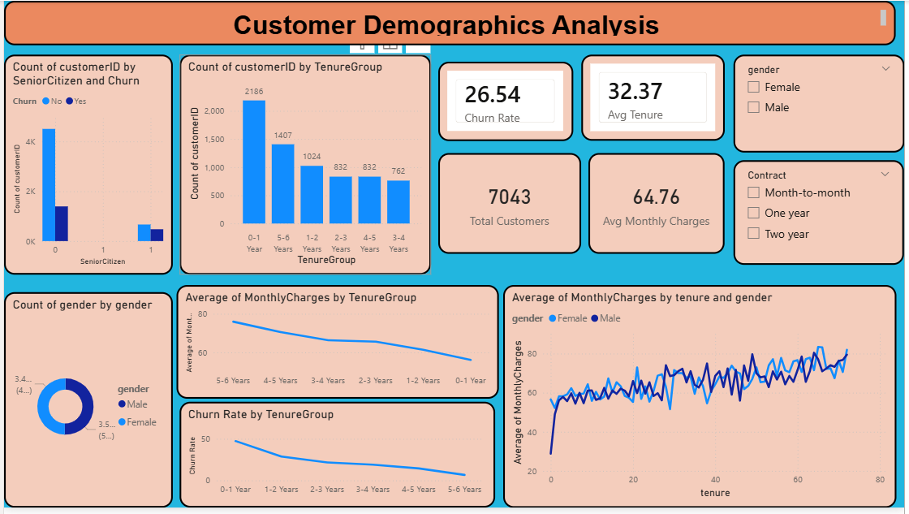

Slide 9
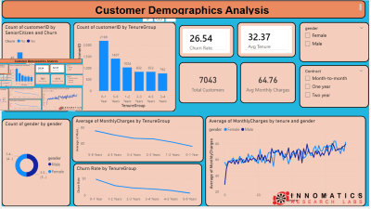

Slide 10
1. Dashboard Visualizations
KPI Cards: Total Customers (7,043), Churn Rate (26.5%), and Revenue Lost.
Pie Chart: Comparing "Stayers" vs. "Leavers".
Bar Chart: Showing Churn by Contract Type (Discovery: Month-to-month friends leave the most!).
Purpose: To see at a glance if the "Leaky Bucket" is getting better or worse.
Why are our customers leaving us?
26% of our friends said goodbye
Fiber optic users leave the most
Month-to-month plans make people quit
Newer customers leave more than old
Paperless billing makes them unhappy
No tech support leads to leaving
We need to keep them happy!

Slide 11
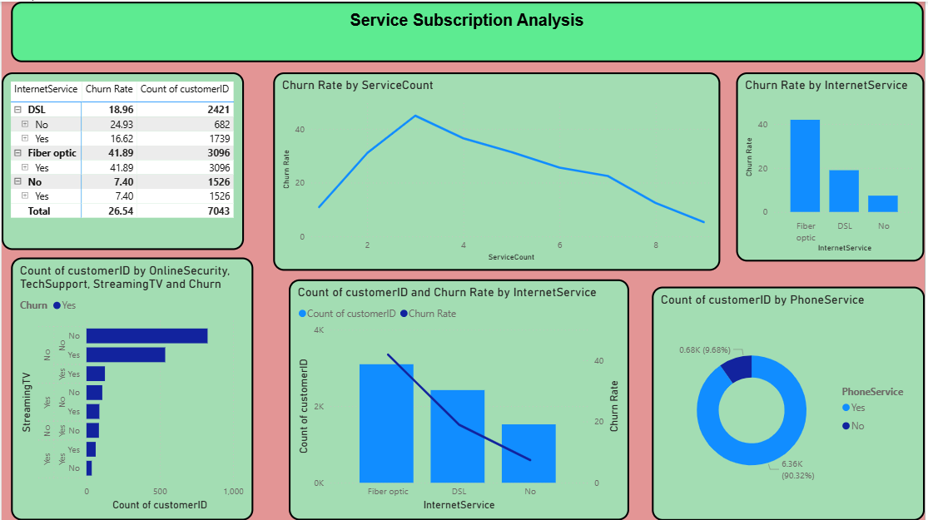

Slide 12
2. SERVICE SECRETS (Internet & Tech)
MATRIX : Showing which internet type has the most leaks (Fiber Optic users are leaving fast!).
Line & Clustered column Chart: Seeing how many people have "Tech Support." (Hint: People with no help leave more!).
Donut Chart: Churn by Online Security and Streaming habits.
Purpose: To find out if our "toys" (services) are the reason people are leaving.

Slide 13
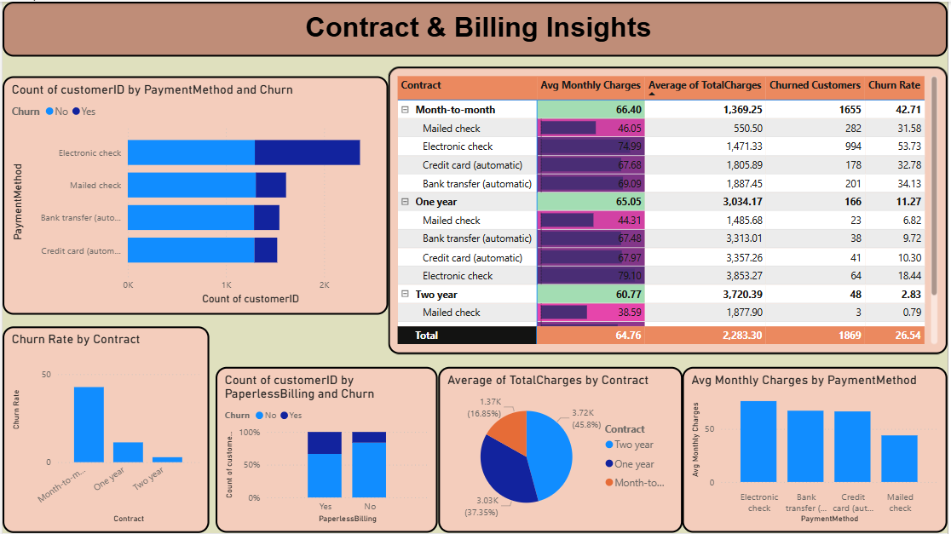

Slide 14
3. MONEY & LOYALTY (Billing Analysis)
Visuals Used:
Line Chart: Showing that "New Friends" (under 6 months) leave much more than "Old Friends".
Scatter Plot: Relationship between high monthly bills and leaving the club.
Bar Chart: Filter by Payment Method (Electronic Check users have a high churn rate!).
Purpose: To see if our club is too expensive for our friends.

Slide 15
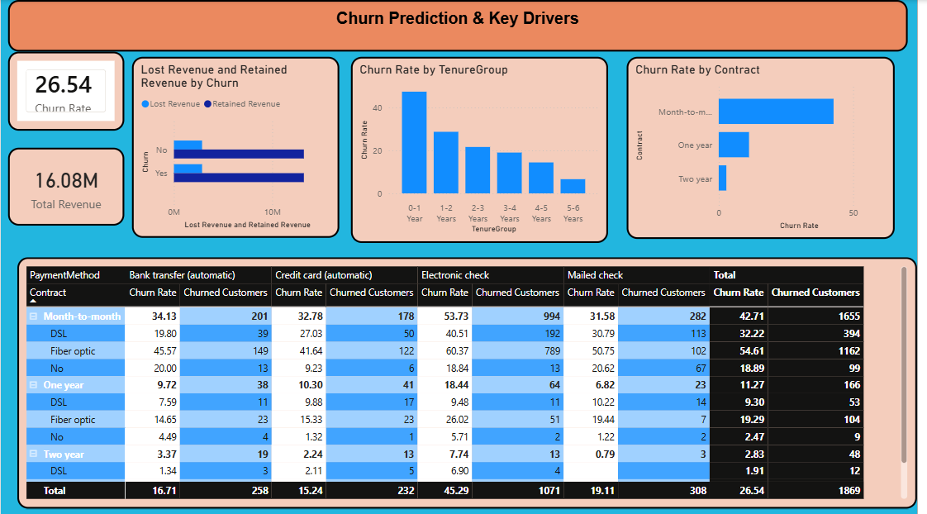

Slide 16
4. Key Drivers of Customer Churn
Overall churn rate sits at 26.54%
Short-term contracts are the primary risk.
First-year customers require urgent retention focus.
Electronic check users churn most frequently.
Fiber optic service shows high dissatisfaction.
Automatic payments significantly improve customer loyalty.
Long-term contracts effectively minimize revenue loss.

Slide 17
Applications & Recommendations
Offer rewards for long-term contracts.
Give free tech help to everyone.
Send welcome gifts to new customers.
Give discounts to high-paying users.
Use "Smart Map" to stop leavers.
Help customers before they feel sad.
Happy customers stay for many years.

Slide 18
Conclusion
Data helps us keep more customers.
Cleaning info makes our results better.
Helping people makes them stay loyal.
Long contracts lead to big success.
We can predict the future now.
Saving customers saves the company money.
Smart data makes a better world.

Slide 19

THANK YOU

